Slide 1







CAPSTONE PROJECT
MANJOT KAUR
2022-12-13

Slide 2



OUTLINE
Executive Summary
Introduction
Methodology
Results
Visualization – Charts
Dashboard
Discussion
Findings & Implications
Conclusion
Appendix

Slide 3

EXECUTIVE SUMMARY
Programming Language Trends
Database Trends
Discussions
Conclusion
Appendix

Slide 4

INTRODUCTION
Methodology
Results
Dashboards
Discussions
findings
Implications

Slide 5

METHODOLOGY
Dashboard
Boxplot
Histogram
Bar charts
Data sources:
https://cf-courses-data.s3.us.cloud-object-storage.appdomain.cloud/IBM-DA0321EN-SkillsNetwork/LargeData/m2_survey_data.csv
https://cf-courses-data.s3.us.cloud-object-storage.appdomain.cloud/IBM-DA0321EN-SkillsNetwork/labs/datasets/Programming_Languages.html

Slide 6
RESULTS
Most of our respondents desire Javascript and Html/CSS​
Few of the respondents are currently using PHP or C++.​
In the future we estimate that very few respondents will use Go and Kotlin.​
Most respondents are currently working with MySQL
Data shows that in the future PostgreSQL will be most desired.
Firebase and Elastic search are barely considered by most respondents.
Dashboard shows us top languages, webframeworks and platforms preferred by most respondents.
Its evidently clear that the majority of the respondents identify as man as depicted by the map.

Slide 7
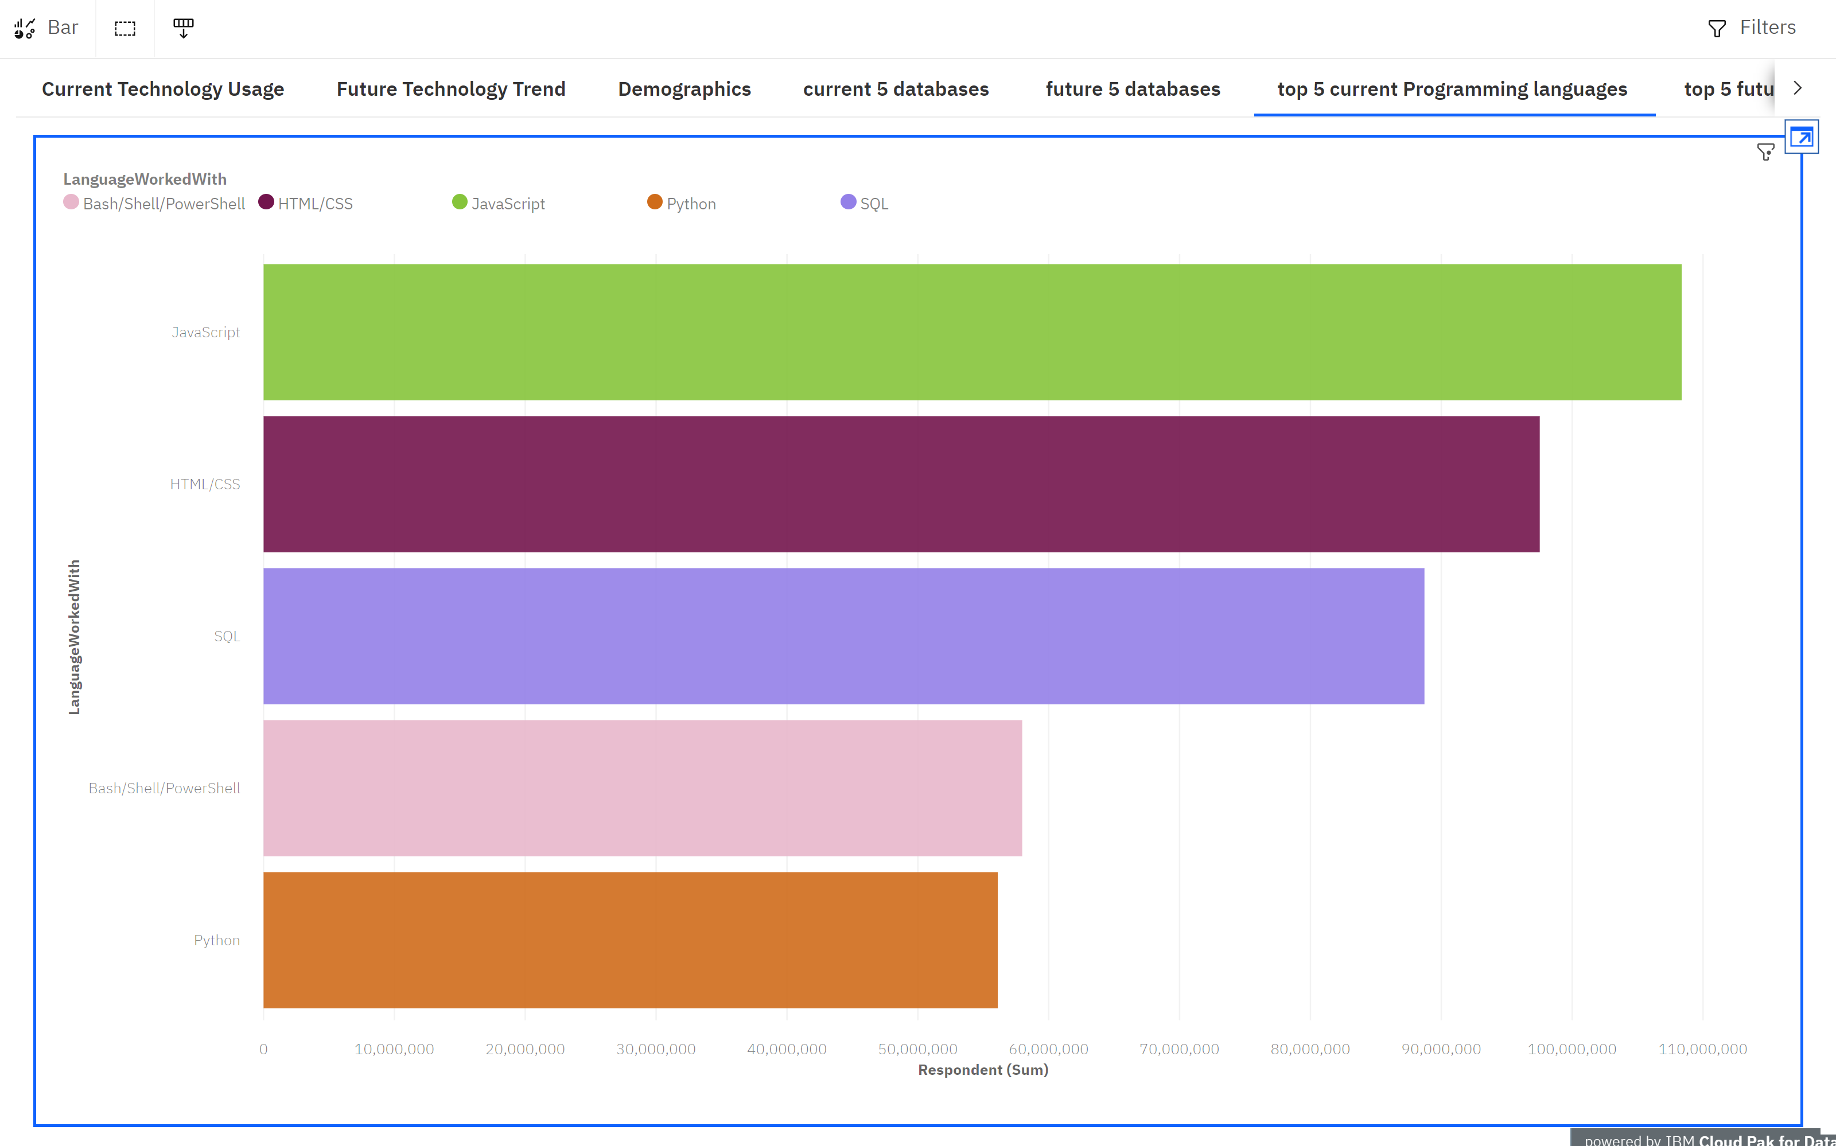
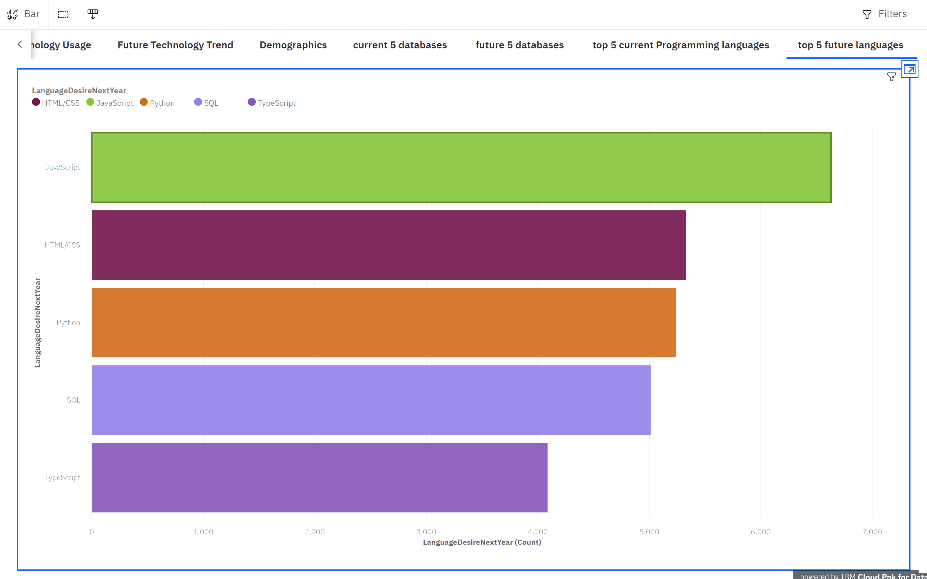
PROGRAMMING LANGUAGE TRENDS
Current Year
Next Year
<Bar chart of top 5 programming languages for the current year goes here.>
< Bar chart of top 5 programming languages for the next year goes here.>

Slide 8
PROGRAMMING LANGUAGE TRENDS - FINDINGS & IMPLICATIONS
Findings
Javascript and Html/CSS are most used.
PHP,C++ are currently not favored.
Go and Kotlin will be less desired in the future.
Implications
Most of our respondents desire Javascript and Html/CSS
Few of the respondents are currently using PHP or C++.
In the future we estimate that very few respondents will use Go and Kotlin.

Slide 9
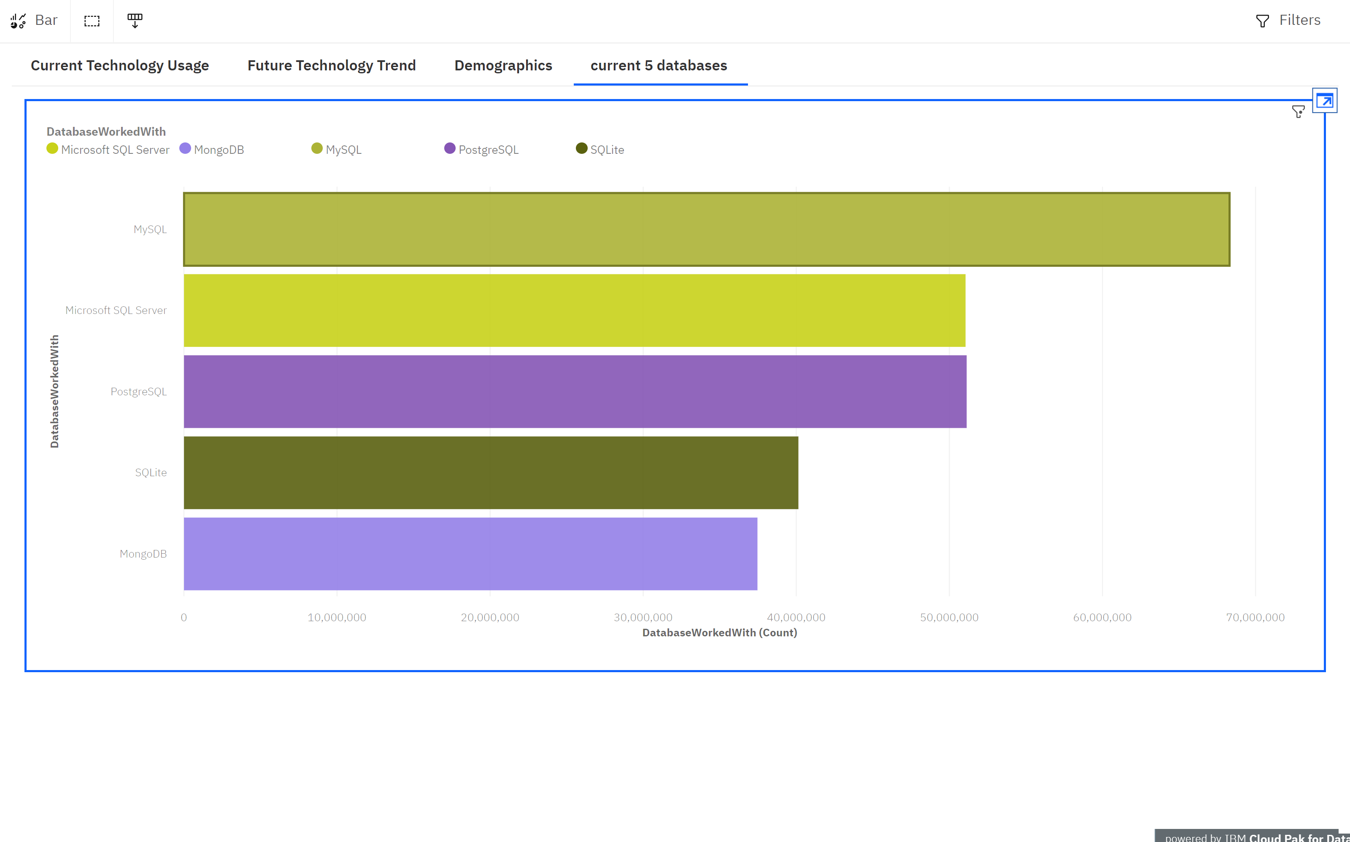
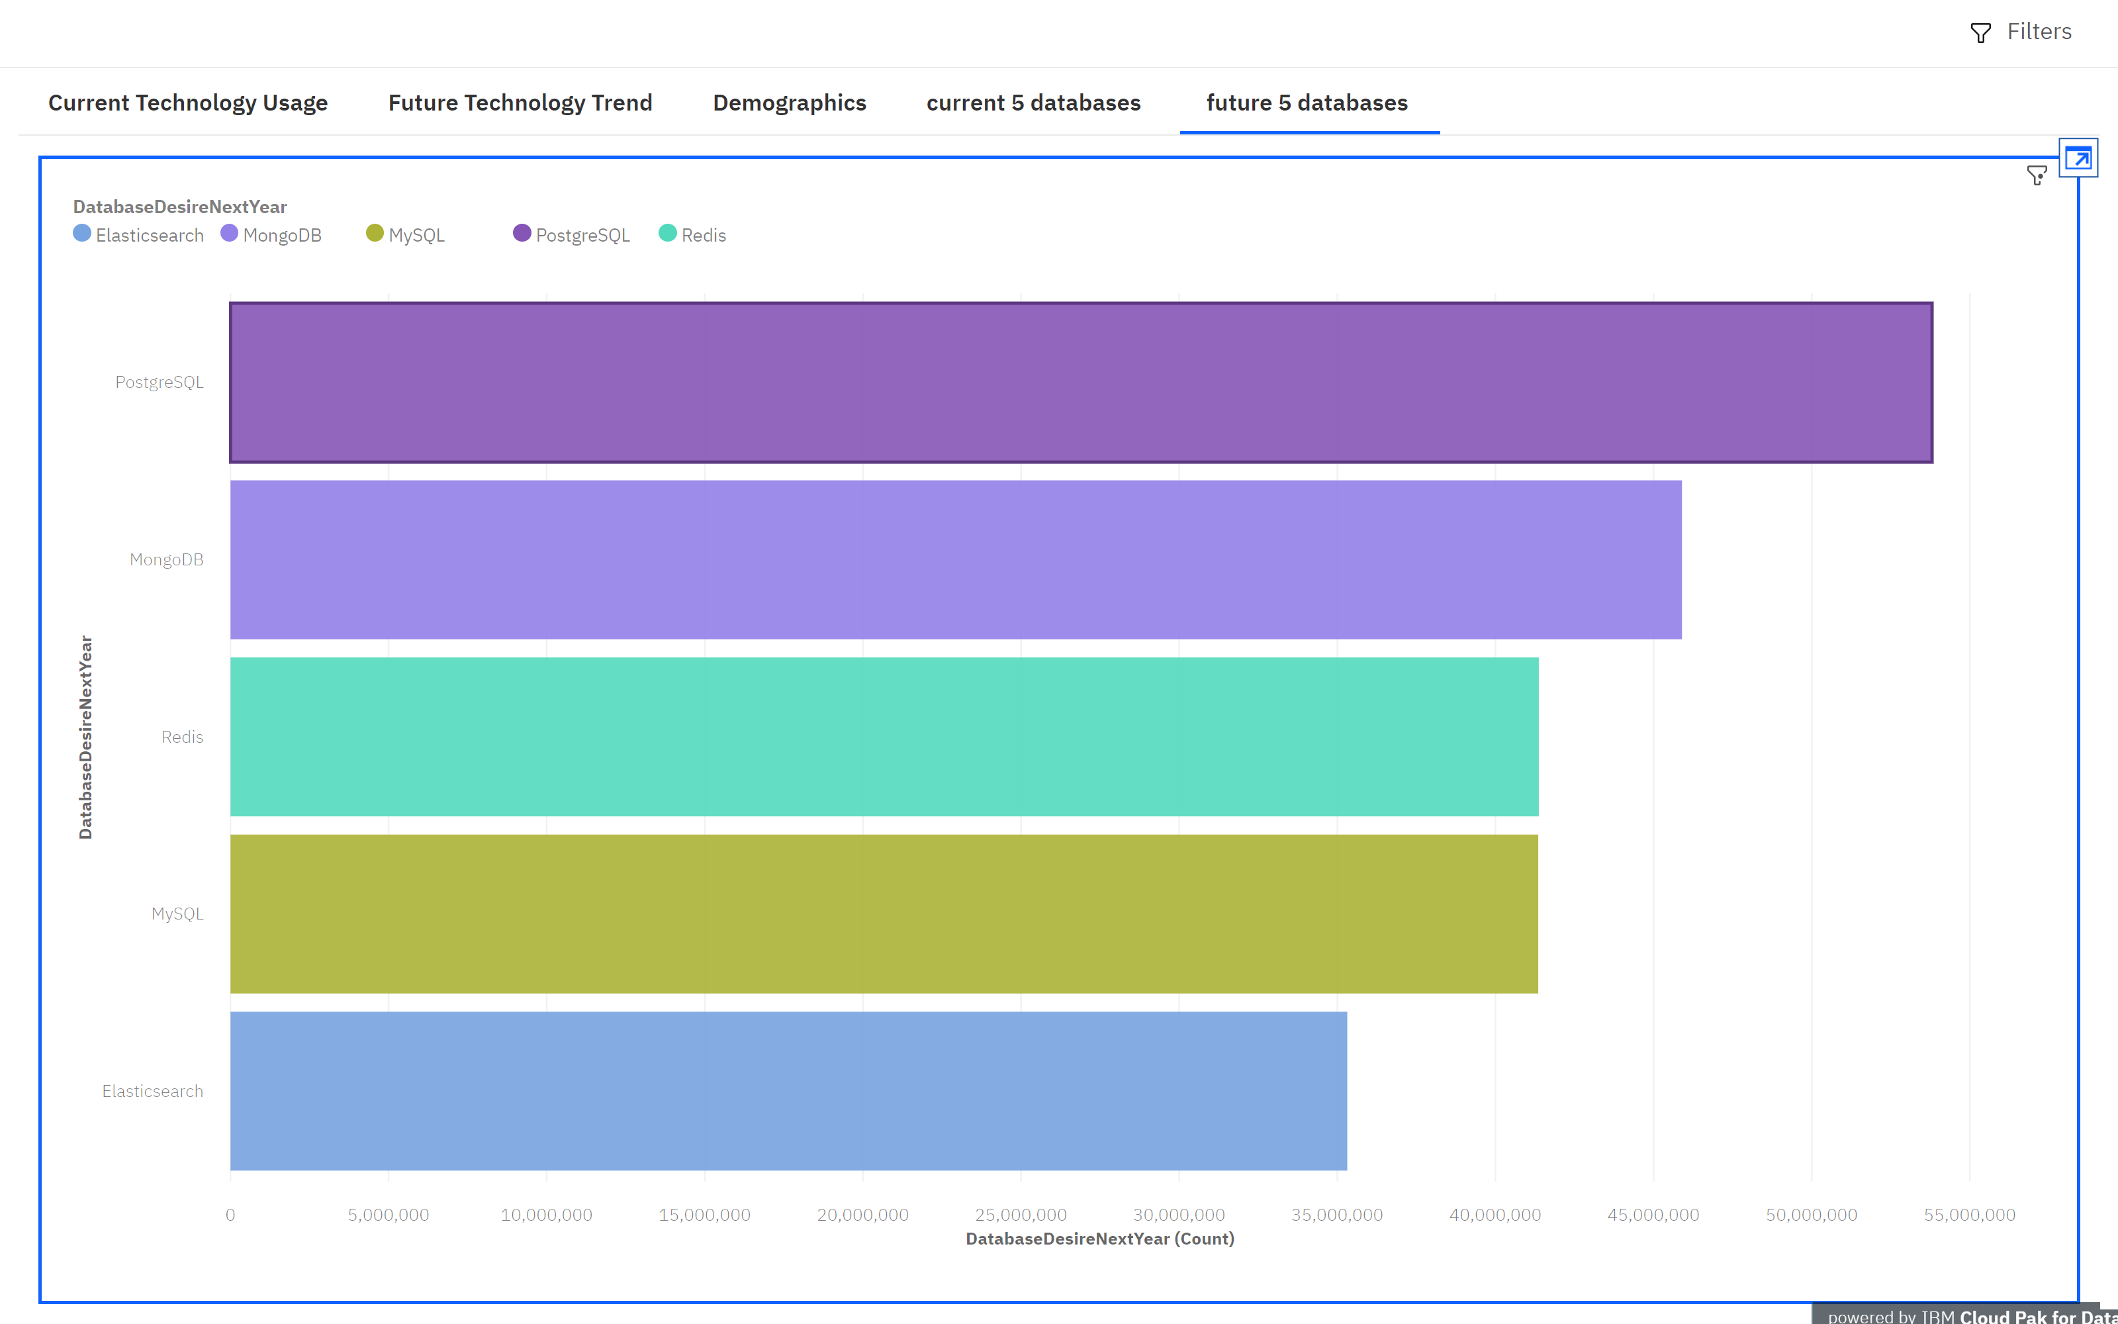
DATABASE TRENDS
Current Year
Next Year
< Bar chart of top 5 databases for the current year goes here >
< Bar chart of top 5 databases for the next year goes here.>

Slide 10
DATABASE TRENDS - FINDINGS & IMPLICATIONS
Findings
Currently MySQL is most worked with
In the future PostgreSQL will be mostly desired
Firebase and Elastic search are barely used.
Implications
Most respondents are currently working with MySQL
Data shows that in the future PostgreSQL will be most desired.
Firebase and Elastic search are barely considered by most respondents.

Slide 11

DASHBOARD
https://dataplatform.cloud.ibm.com/dashboards/d613f444-390b-4ce5-aad9-aef028a3de24/view/610aa4177d836de243e6e2e407cf2f0178637059b3bb845289877b495c637997a93f1590c82b4e5d89450231f0ef1a59cb

Slide 12
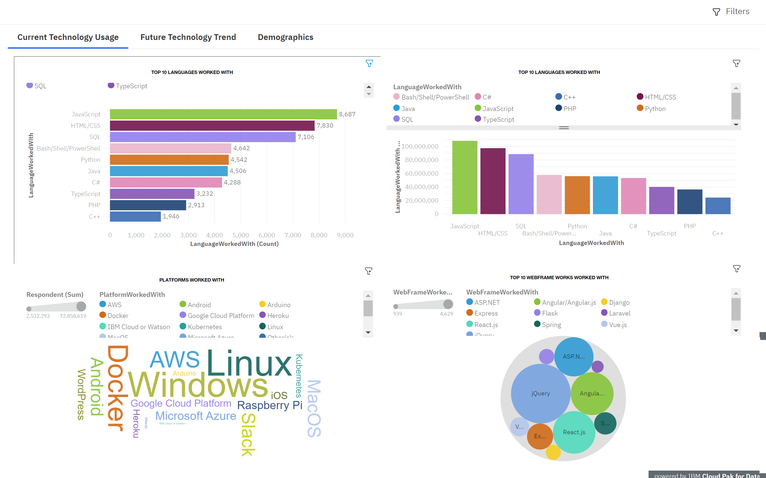
DASHBOARD TAB 1
Screenshot of dashboard tab 1 goes here

Slide 13
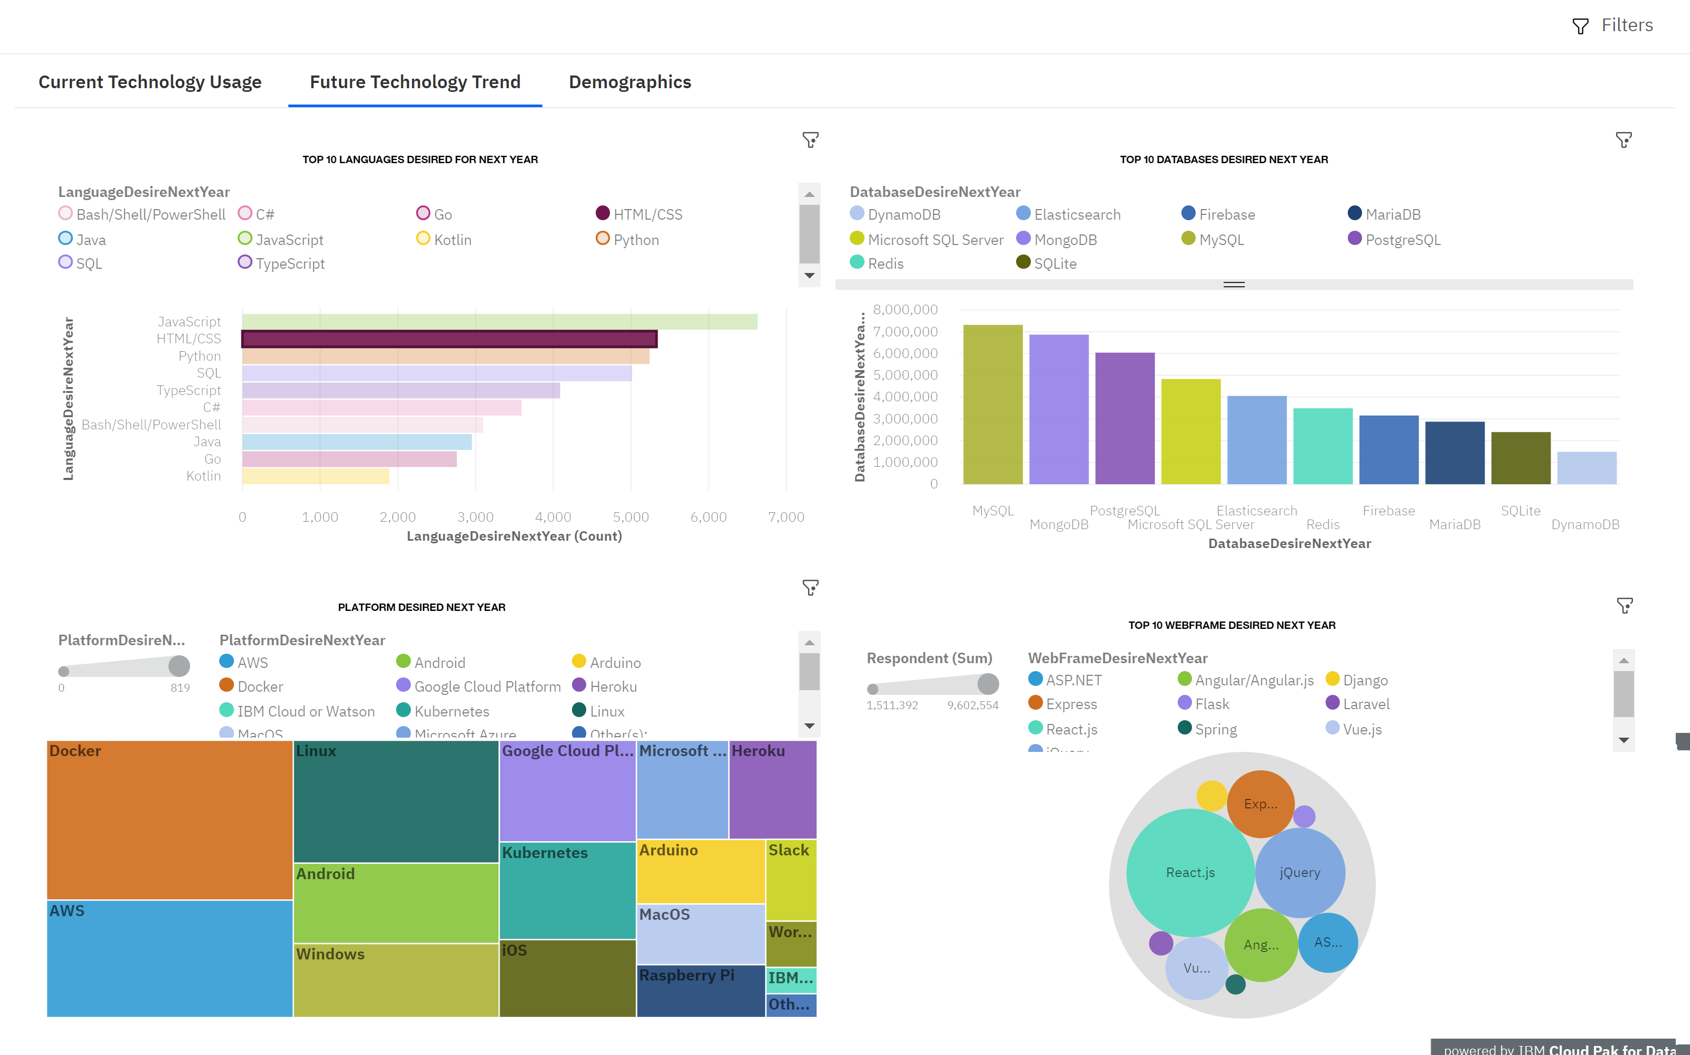
DASHBOARD TAB 2
Screenshot of dashboard tab 2 goes here

Slide 14
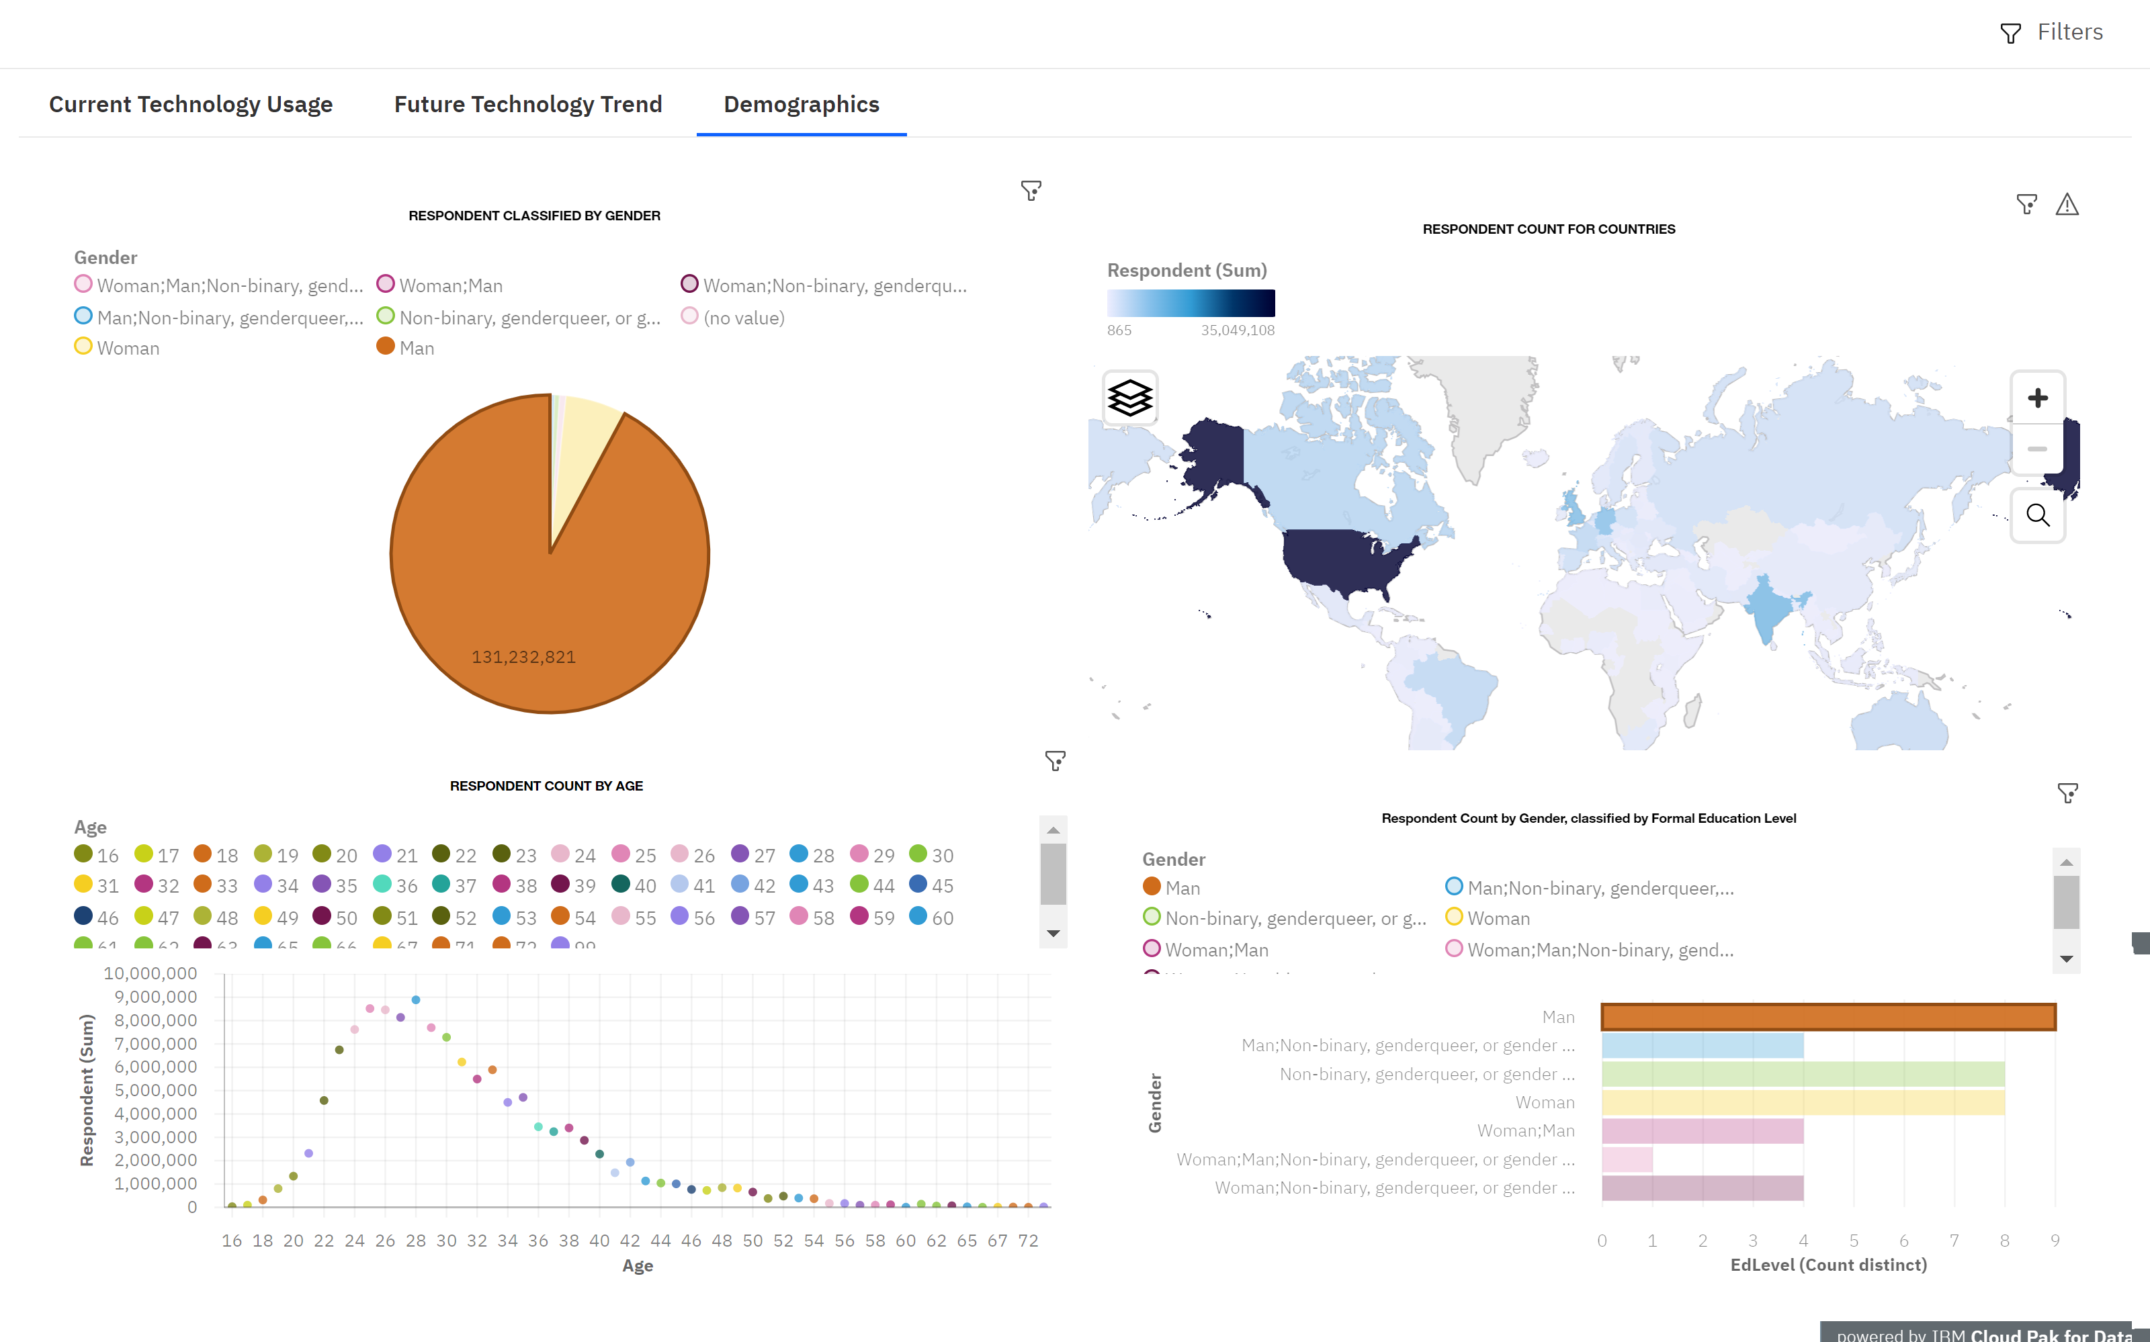
DASHBOARD TAB 3
Screenshot of dashboard tab 3 goes here

Slide 15
DISCUSSION
Dashboard shows us top languages,webframeworks and platforms preferred by most respondents.
Its evidently clear that the majority of the respondents identify as man as depicted by the map.

Slide 16
OVERALL FINDINGS & IMPLICATIONS
Findings
Javascript is most worked with
Most desired database is MySQL
There are more respondents in the united states than any other country
Implications
More people are taking on Javascript
MySQL,Docker,javascript and React.js have gained popularity.
The majority of the respondents identify as male.

Slide 17

CONCLUSION
Javascript is the most preferred language.
MySQL is the most preferred database.
Most respondents are familiar with
Majority of the respondents identify as man.

Slide 18

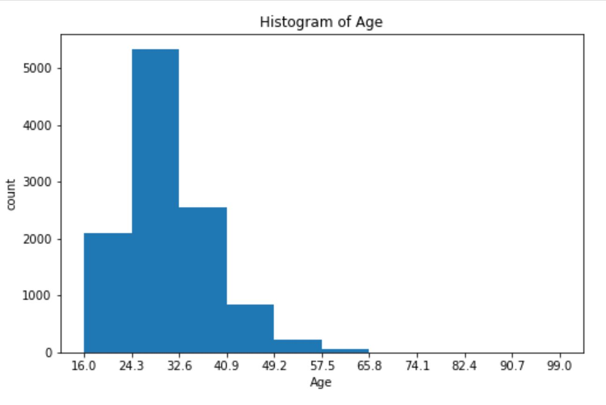
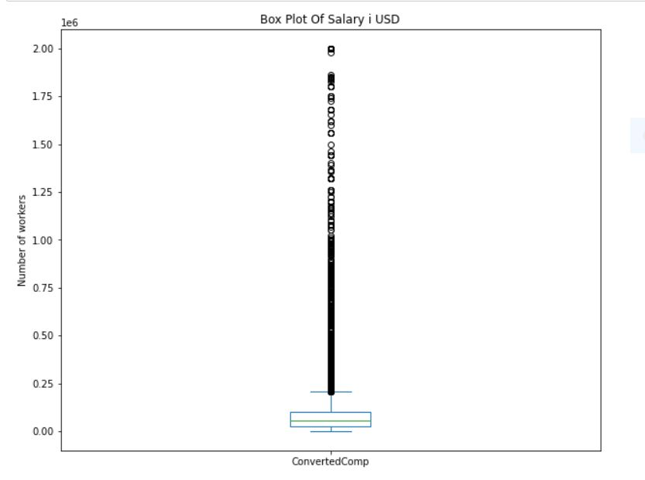
APPENDIX
Include any relevant additional charts, or tables that you may have created during the analysis phase.

Slide 19
JOB POSTINGS
In Module 1 you have collected the job posting data using Job API in a file named “”. Present that data using a bar chart here. Order the bar chart in the descending order of the number of job postings.

Slide 20
POPULAR LANGUAGES
In Module 1 you have collected the job postings data using web scraping in a file named “popular-languages.csv”. Present that data using a bar chart here. Order the bar chart in the descending order of salary.

